Slide 1
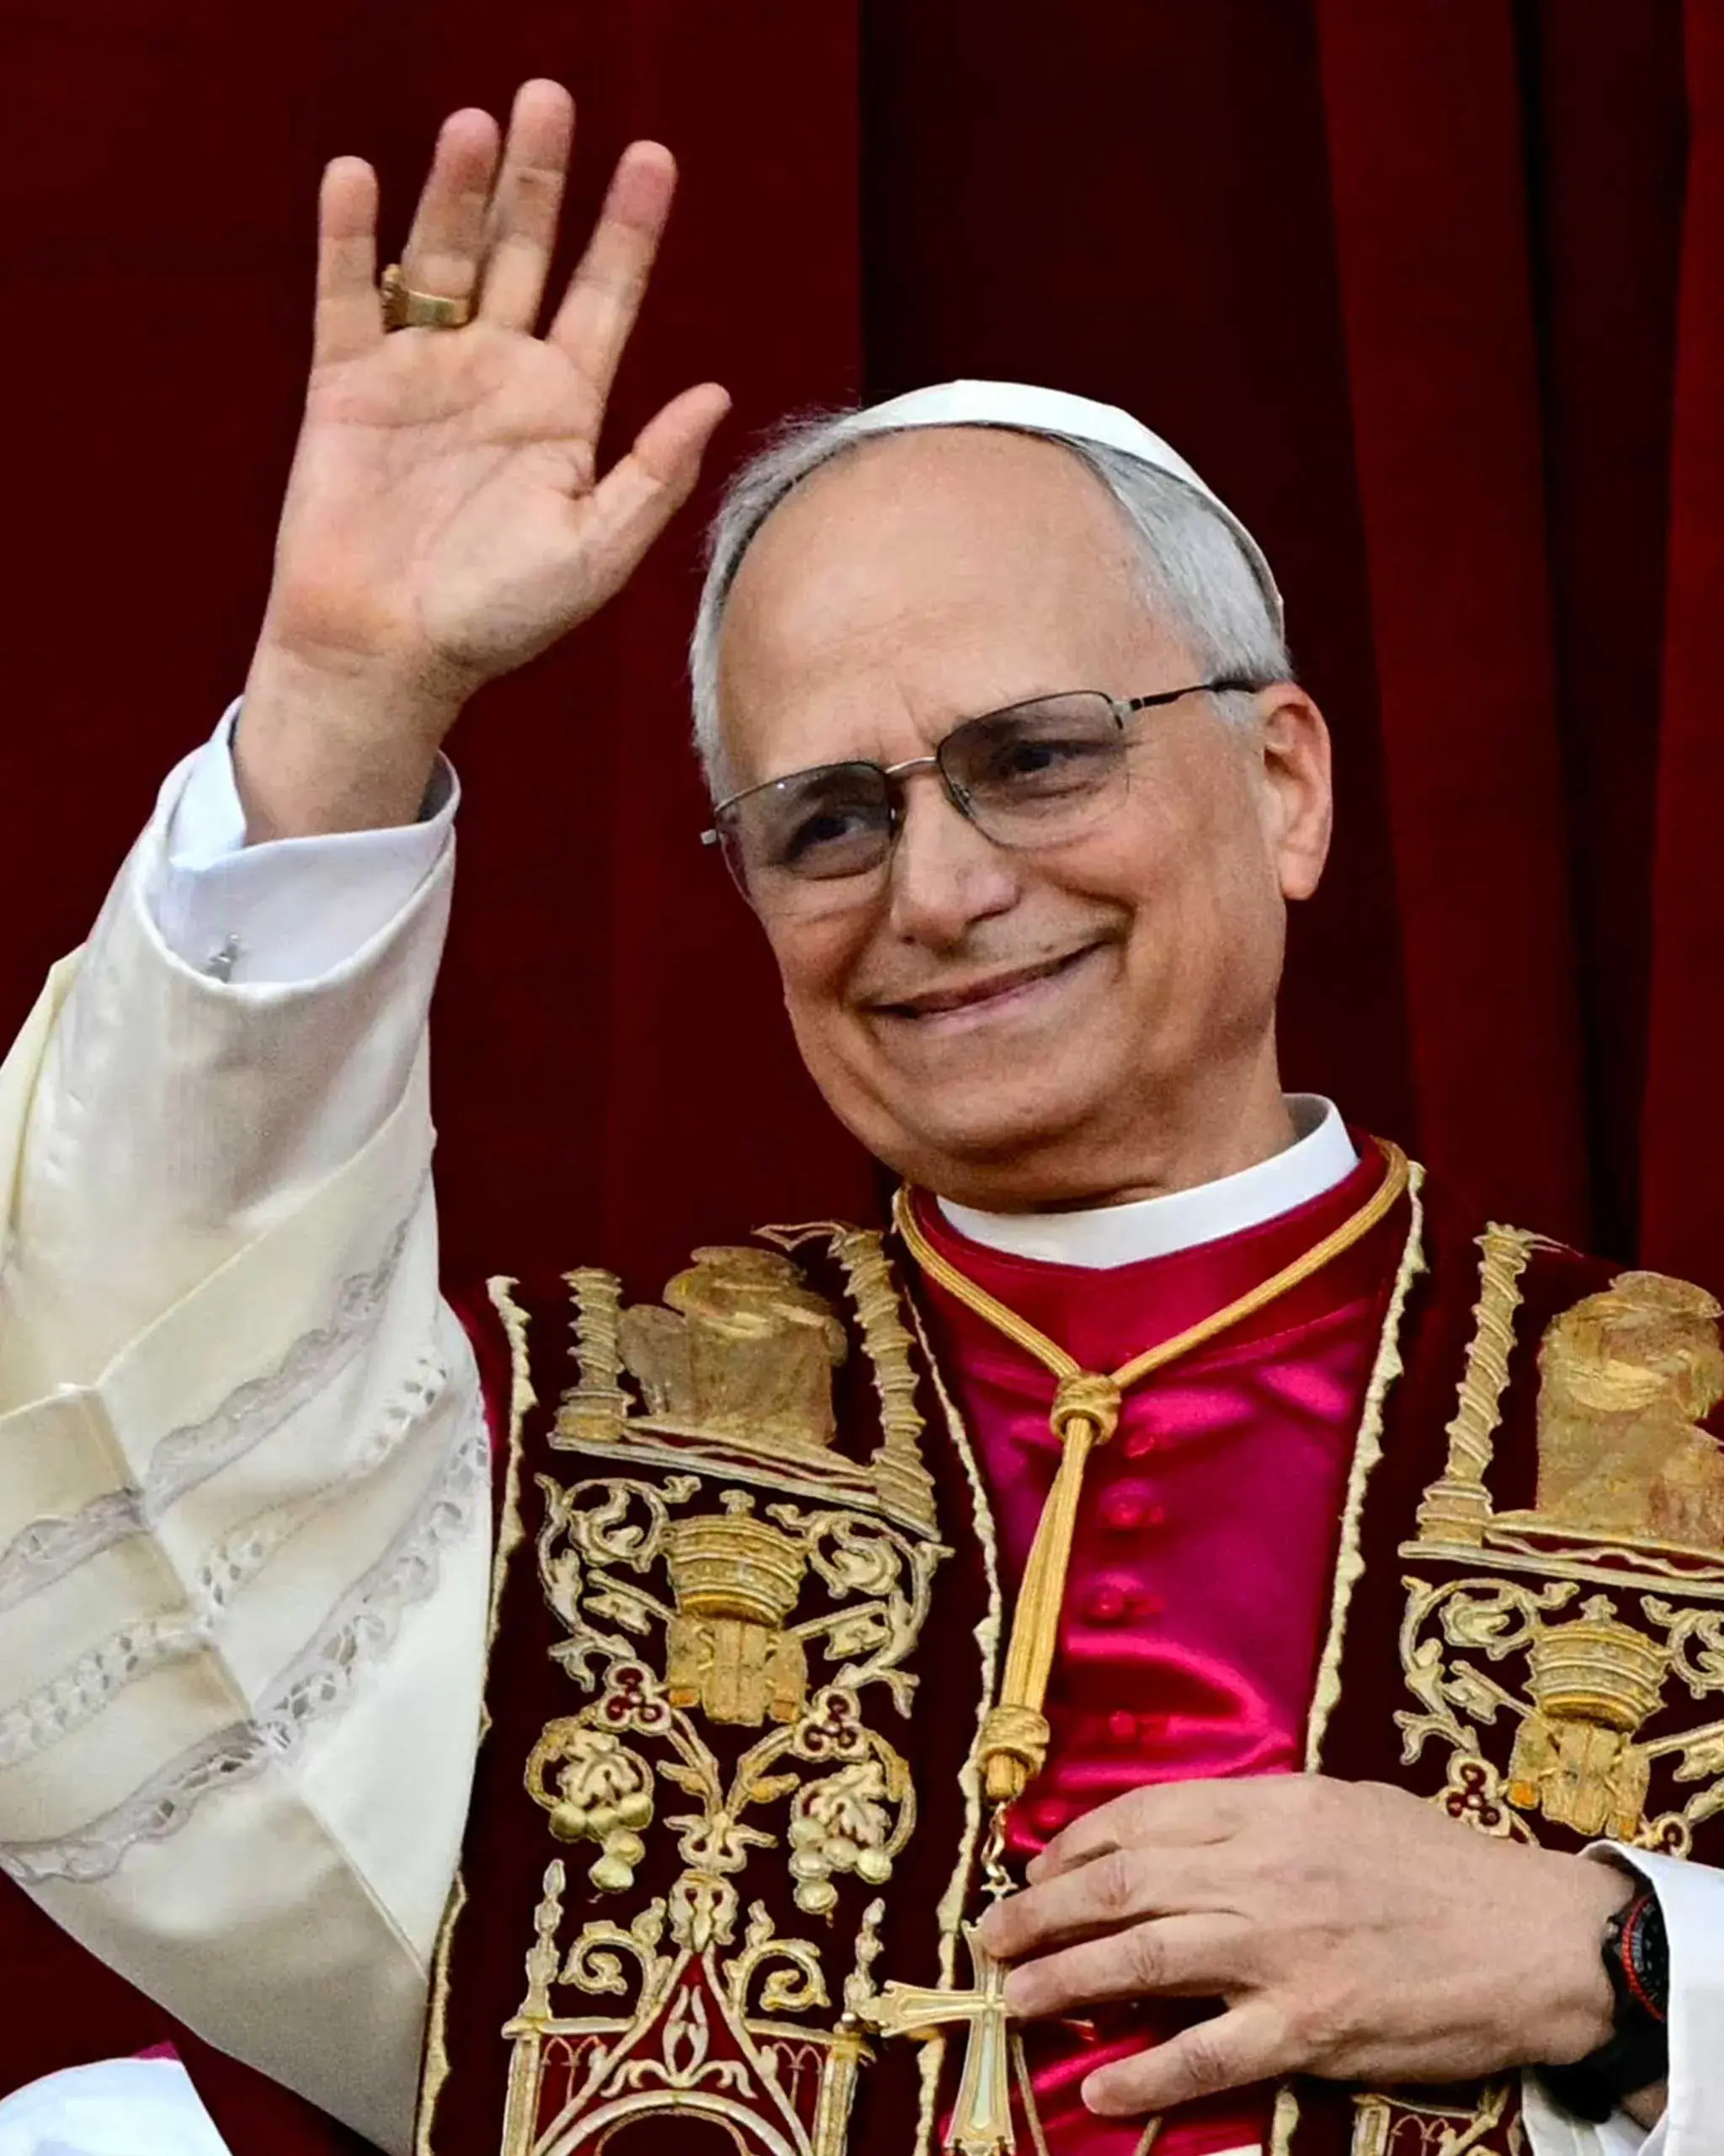
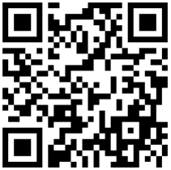
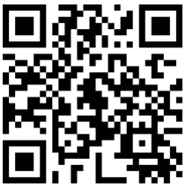
Sunday 11th May 2025
IV Sunday of Easter – Good Shepherd Sunday
World Day of Prayer for Vocations
Liturgical Colour: WHITE
Second Collection - Diocesan Priests Training Fund
5:00pm(Sat) (STM) Vigil Holy Mass (Jacqui Gudge RIP)
9:15am (MHNJ) Holy Mass (Pro populo)
11:00am (SPA) Holy Mass (Hettie O’Brien RIP)
Rest of the Week
Monday (SPA) Memorial of Ss Nereus & Achilleus
10:00am Holy Mass (Fr Stephen McGuinnes RIP)
Tuesday (SPA) Memorial of Our Lady of Fátima
09:00am Holy Mass ()
Thursday (SPA) Feria of Easter
10:00am Holy Mass followed by Holy Hour
10:30-11:15am CONFESSIONS
Friday (MHNJ) Feria of Easter
10:00am Holy Mass followed by CONFESSIONS
Saturday (SPA)
10:30-11:00am CONFESSIONS
CONFESSIONS: As advertised above or by appointment
MHNJ: Most Holy Name of Jesus church, OUNDLE
SPA: St Paul the Apostle church, THRAPSTON
STM: St Thomas More chapel, RAUNDS
Habemus Papam!
His Holiness, Pope Leo XIV
Baptism
Beatrice Nell Leonard Draper will be baptised at St Paul’s Thrapston on Saturday 10th May at 11am.
Please pray for Beatrice and her family.
Upcoming Second Collections
18th May – Diocesan Bishops’ Fund: for the financial support of the Bishop’s house and the curial offices
To sign-up to CASPAR, our Cluster Database, please use the QR Codes below or simply type in the address into your web browser.
Thrapston & Raunds
www.caspar.church/me?ID=56088
Oundle
www.caspar.church/me?ID=56072
Listening and Discernment Process
There will be changes in our cluster as well as in the whole deanery. This is an opportunity for every catholic to express their thoughts and hopes for the future of our community.
There will be meetings at:
Most Holy Name’s church on 10th May at 11am
St Thomas More’s church on 17th May at 11am
St Paul’s church on 24th May at 11am
Troubles with CASPAR?
If you have troubles viewing or receiving our Newsletter via CASPAR, please contact the support team via:
Email Us at support@caspar.church
- Phone Us on 01440 730399
MEETING TIMES THIS WEEK
FIRST HOLY COMMUNION COURSE
Meetings on Mondays at 5pm during term-time.
PARISHIONERS PRAYER GROUP - Every Tuesday via Zoom at 7pm
RAUNDS PRAYER GROUP Every Friday at St Thomas More chapel
2.00pm Rosary and Divine Mercy chaplet
3.00pm Stations of the Cross
Jubilee Year 2025
Pilgrims of Hope
to watch videos, click on image.
Parish Priest: Fr Benedetto D’Autilia email: frbenedetto.dautilia@northamptondiocese.org
Parish Secretary: Meg Shepherd (Thurs 11am-1pm) email: parish.eastnorthants@northamptondiocese.org
Presbytery & Office TEL. 01832 617 050 Newsletter items to be emailed to Meg by Wednesday
DIOCESAN NEWS: https://northamptondiocese.org/news/

Slide 2
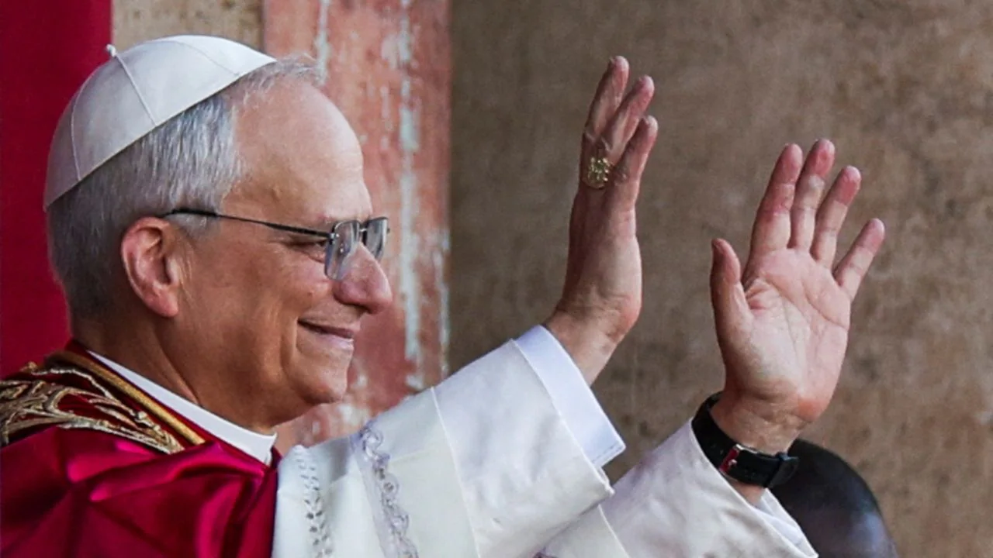
HABEMUS PAPAM! - LEO XIV
“You are the Christ, the Son of the living God” (Mt 16:16). In these words, Peter, asked by the Master, together with the other disciples, about his faith in him, expressed the patrimony that the Church, through the apostolic succession, has preserved, deepened and handed on for two thousand years.
Jesus is the Christ, the Son of the living God: the one Savior, who alone reveals the face of the Father. In him, God, in order to make himself close and accessible to men and women, revealed himself to us in the trusting eyes of a child, in the lively mind of a young person and in the mature features of a man (cf. Gaudium et Spes, 22), finally appearing to his disciples after the resurrection with his glorious body. He thus showed us a model of human holiness that we can all imitate, together with the promise of an eternal destiny that transcends all our limits and abilities. Peter, in his response, understands both of these things: the gift of God and the path to follow in order to allow himself to be changed by that gift. They are two inseparable aspects of salvation entrusted to the Church to be proclaimed for the good of the human race. Indeed, they are entrusted to us, who were chosen by him before we were formed in our mothers’ wombs (cf. Jer 1:5), reborn in the waters of Baptism and, surpassing our limitations and with no merit of our own, brought here and sent forth from here, so that the Gospel might be proclaimed to every creature (cf. Mk 16:15).
In a particular way, God has called me by your election to succeed the Prince of the Apostles, and has entrusted this treasure to me so that, with his help, I may be its faithful administrator (cf. 1 Cor 4:2) for the sake of the entire mystical Body of the Church. He has done so in order that she may be ever more fully a city set on a hill (cf. Rev 21:10), an ark of salvation sailing through the waters of history and a beacon that illumines the dark nights of this world. And this, not so much through the magnificence of her structures or the grandeur of her buildings – like the monuments among which we find ourselves – but rather through the holiness of her members. For we are the people whom God has chosen as his own, so that we may declare the wonderful deeds of him who called us out of darkness into his marvelous light (cf. 1 Pet 2:9).
Peter, however, makes his profession of faith in reply to a specific question: “Who do people say that the Son of Man is?” (Mt 16:13). The question is not insignificant. It concerns an essential aspect of our ministry, namely, the world in which we live, with its limitations and its potential, its questions and its convictions.
“Who do people say that the Son of Man is?” If we reflect on the scene we are considering, we might find two possible answers, which characterize two different attitudes. First, there is the world’s response. Matthew tells us that this conversation between Jesus and his disciples takes place in the beautiful town of Caesarea Philippi, filled with luxurious palaces, set in a magnificent natural landscape at the foot of Mount Hermon, but also a place of cruel power plays and the scene of betrayals and infidelity. This setting speaks to us of a world that considers Jesus a completely insignificant person, at best someone with an unusual and striking way of speaking and acting. And so, once his presence becomes irksome because of his demands for honesty and his stern moral requirements, this “world” will not hesitate to reject and eliminate him.
Then there is the other possible response to Jesus’ question: that of ordinary people. For them, the Nazarene is not a charlatan, but an upright man, one who has courage, who speaks well and says the right things, like other great prophets in the history of Israel. That is why they follow him, at least for as long as they can do so without too much risk or inconvenience. Yet to them he is only a man, and therefore, in times of danger, during his passion, they too abandon him and depart disappointed. What is striking about these two attitudes is their relevance today. They embody notions that we could easily find on the lips of many men and women in our own time, even if, while essentially identical, they are expressed in different language.
Even today, there are many settings in which the Christian faith is considered absurd, meant for the weak and unintelligent. Settings where other securities are preferred, like technology, money, success, power, or pleasure.
These are contexts where it is not easy to preach the Gospel and bear witness to its truth, where believers are mocked, opposed, despised or at best tolerated and pitied. Yet, precisely for this reason, they are the places where our missionary outreach is desperately needed. A lack of faith is often tragically accompanied by the loss of meaning in life, the neglect of mercy, appalling violations of human dignity, the crisis of the family and so many other wounds that afflict our society.
Today, too, there are many settings in which Jesus, although appreciated as a man, is reduced to a kind of charismatic leader or superman. This is true not only among non-believers but also among many baptized Christians, who thus end up living, at this level, in a state of practical atheism. This is the world that has been entrusted to us, a world in which, as Pope Francis taught us so many times, we are called to bear witness to our joyful faith in Jesus the Savior. Therefore, it is essential that we too repeat, with Peter: “You are the Christ, the Son of the living God” (Mt 16:16). It is essential to do this, first of all, in our personal relationship with the Lord, in our commitment to a daily journey of conversion. Then, to do so as a Church, experiencing together our fidelity to the Lord and bringing the Good News to all (cf. Lumen Gen., 1).
I say this first of all to myself, as the Successor of Peter, as I begin my mission as Bishop of Rome and, according to the well-known expression of Saint Ignatius of Antioch, am called to preside in charity over the universal Church (cf. Letter to the Romans, Prologue). Saint Ignatius, who was led in chains to this city, the place of his impending sacrifice, wrote to the Christians there: “Then I will truly be a disciple of Jesus Christ, when the world no longer sees my body” (Letter to the Romans, IV, 1). Ignatius was speaking about being devoured by wild beasts in the arena – and so it happened – but his words apply more generally to an indispensable commitment for all those in the Church who exercise a ministry of authority. It is to move aside so that Christ may remain, to make oneself small so that he may be known and glorified (cf. Jn 3:30), to spend oneself to the utmost so that all may have the opportunity to know and love him.
May God grant me this grace, today and always, through the loving intercession of Mary, Mother of the Church.
FIRST HOMILY OF POPE LEO XIV
I will begin with a word in English, and the rest is in Italian.
But I want to repeat the words from the Responsorial Psalm:
“I will sing a new song to the Lord, because he has done marvels.” And indeed, not just with me but with all of us.
My brother Cardinals, as we celebrate this morning, I invite you to recognize the marvels that the Lord has done, the blessings that the Lord continues to pour out on all of us through the Ministry of Peter. You have called me to carry that cross, and to be blessed with that mission, and I know I can rely on each and every one of you to walk with me, as we continue as a Church,
as a community of friends of Jesus, as believers to announce the Good News, to announce the Gospel.

Slide 3
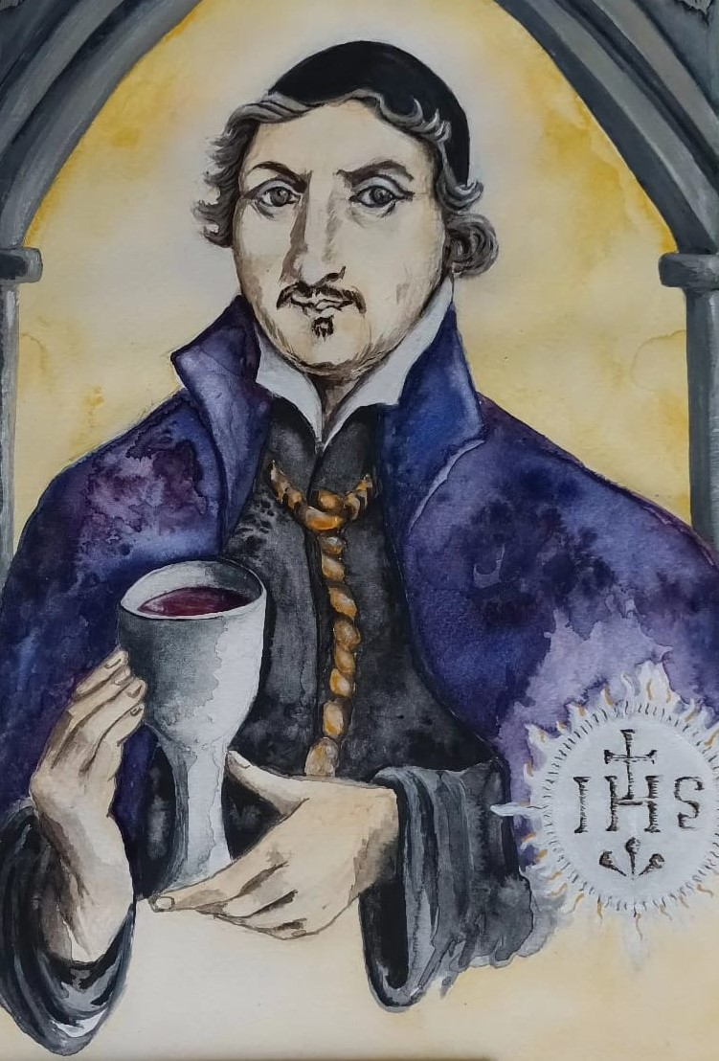
Parish Giving
Regular standing order donations may be made directly to your Parish or by standing order:
St Paul the Apostle | Thrapston
St Thomas More| Raunds
Nat West Account : RCDN St Pauls Parish Thrapston
Sort Code : 60-06-11
Account No: 65068874
The Most Holy Name of Jesus | Oundle
Nat West
Account Name : RCDN Most Holy Name of Jesus
Sort Code: 60-06-11
Account No : 46714626
Please complete a “Gift-Aid” declaration and your Parish receives tax refund cash on your behalf. Please ask for a form by email.
www.svp.org.uk
svp140512@gmail.com Joe Gasan on 07565 395955
CLUSTER NOTICES
Requiescat In Pace
Please pray for the repose of the soul of our sister Jacqueline (Jacqui) Gadge, who passed away last Sunday
after having been comforted by the Sacraments of the Church.
Please support Jaqui’s family with your prayers in this difficult time.
REGINA CAELI
During Easter time we will sing the Marian antiphon Regina Caeli at the end of Mass. Those who want to learn it, can listen to the marvellous recording below:
https://www.youtube.com/watch?v=ElNfiLCLb7g
PASTORAL VISITATION - 14th-15th June 2025
On Sunday 14th-15th June the people of the Cluster of Blessed Peter Wright will have a Pastoral Visitation by the Rt Rev Dr David James Oakley, Bishop of Northampton.
Bishop David will visit the two Catholic parish churches of the Most Holy Name of Jesus, Oundle and of St Paul the Apostle, Thrapston with the chapel of St Thomas More, Raunds.
Many of you might ask: "What is a Pastoral Visitation?" It is a way for a Bishop to come into personal contact with the clergy and especially with the many people responsible for various areas of the pastoral life of the parish. Through this visit the bishop becomes acquainted with the reality of the environment, the socio-economic condition of the people, the current pastoral programs, and the overall functioning of the parish. It is a time of grace for the entire Catholic community of the area, whose chief pastor visits to bring encouragement and hope to those involved in pastoral work and to all the people of the parish. He will celebrate the Eucharist, proclaim the Word of God and preach the wonders of our wonderful Catholic faith. The bishop visits a parish, which is not a building but rather the people who make it. He will make known the pastoral priorities of the whole diocese and will foster a sense of belonging to the diocesan Church, which is the Local Church of Northampton.
Thank You
A heartfelt thank you to everyone who joined us for refreshments and cakes after mass on Sunday, 4th May at MHNJ. It was a lovely opportunity to come together as a parish and support two great causes: our own church and Restless Development.
We are delighted to share that £260 was raised— £130 for Restless Development and £130 for MHNJ (with card donations yet to be added). Thank you for your generosity and kindness.
Our warm thanks also go to Orla and Jaspal for providing hot drinks and helping to make the event so welcoming.
To learn more or donate, visit: www.schoolstriathlon.org/e/oundle-school-schools-triathlon-7474
With sincere thanks and God bless,
Anastasia (on behalf of Year 5 Superstars team)
HOLY COMMUNION
A reminder about when to approach the altar for the reception of Holy Communion. Once the priest has drunk the Most Precious Blood from the chalice and the bell is rung, please start making your way to the altar (sanctuary). This will make communion swifter and will show our spiritual willingness that we truly desire to be fed by Christ.
Diaconate Open Day
Considering the Diaconate? Are you feeling called to serve in a deeper way? Come and learn about the ministry of the Permanent Diaconate in our diocese at an Information Morning on Saturday, 31st May, from 10:00 AM to 12:00 PM at St. Mary's Parish, 82 West St., Dunstable. For more information, contact Fr. Tony Brennan at 01582 662710 or franthony.brennan@northamptondiocese.org
Prayer For the Canonisation
of Blessed Peter Wright
Eternal Father, your priest and
martyr, Blessed Peter Wright of the
Society of Jesus, worked with zeal
and dedication in your vineyard and
gave his life freely because of his faith
in you and in your Church.
Through his intercession grant that
this humble flock may reach where
Jesus, our brave Shepherd, has gone.
In blessed Peter’s name, I come to you with my needs:
(pause and silently mention your request)
Lord, help me always to imitate the great faith, generous love, and burning zeal of Blessed Peter. Grant that Your Church may proclaim him as a saint serving at your Throne in Heaven and interceding for us. Through Christ our Lord. Amen.
Safeguarding Key Message
Our key message this year is : ‘The Diocese of Northampton have adopted the National policies of CBCEW’
Key webpages:
https://catholicsafeguarding.org.uk/resources/national-safeguarding-policy/
https://northamptondiocese.org/policies/
To make any enquiries please contact safeguarding office on 01604723514
or safeguarding@northamptondiocese.org
PARISH SAFEGUARDING CONTACT
Safeguarding officer – Sharon Knox
sharon_knox@hotmail.com
Jesus Our Hope
As part of our celebrations for the 2025 Jubilee Year, you are warmly invited to an evening of celebration, inspiration, and hope.
Each evening will include: Prayer, reflection on God’s Word, personal testimony, music and time to socialise over refreshments.
The event is free to attend, but to help us prepare refreshments, we kindly ask that you register in advance.
Event Dates and Locations:
Monday, 12 May – Online
Tuesday, 14 May – 7:00–9:00 PM in Olney
Monday, 9 June – 7:00–9:00 PM in Aylesbury
More information and registration details can be found at: northamptondiocese.org/courses
DIOCESAN NOTICES

Slide 4
Life In The Spirit Seminars 2025
Join us for a series of six inspiring sessions starting May 13th, culminating in a special retreat on June 7th. Sessions will take place at Northampton Cathedral and various hub locations across the diocese.
https://northamptondiocese.org/life-in-the-spirit-seminars-2025/
Pilgrimage to Walsingham
The diocesan pilgrimage will take place on the 14th June 2025. Please contact Deacon Michael Fleming at: deaconmichael.fleming@northamptondiocese.org
Adopt a Cardinal
An online app is available to help the faithful pray for individual Cardinals during the Conclave period. Pray for a Cardinal here: https://praycardinal.com
Called to Love: Masculine & Feminine, 9-11 May 2025
A weekend for single young adults and dating or engaged couples, exploring the nature of masculinity and femininity. The retreat will consider the contemporary challenges to being a man and a woman and the Church’s wisdom for this, drawing particular inspiration from St Pope John Paul II.
For more information and to book: https://christianheritagecentre.com/events/called-to-love/
National Day of Prayer for Survivors of Abuse
20 May 2025 – Theme: “The Empty Chair”
This day recognises the absence of those who cannot return to Church due to abuse. They may be survivors, family members, or others deeply affected. “The Empty Chair” represents their pain and presence.
Divine Mercy Talk
Fr. Chris Alar, MIC, Provincial Superior of the Marian Fathers of the Immaculate Conception at the National Shrine of Divine Mercy in Stockbridge, Massachusetts, will be visiting St. Joseph's Parish, Gerrards Cross on Tuesday, 3rd June at 7:30 PM.
He will speak on "The Significance of the Divine Mercy Devotion." The talk will be followed by a book signing and light refreshments. All are welcome.
Unveiled Faces: Healing & Transformation with the Saints, 27-29 June 2025
A weekend led by Fr Emmanuel Mansford (for all adult laity), CFR contemplating the healing and transformational work of grace in the ordinary and imperfect lives of the saints. In the light of their example, the retreat will offer an opportunity to reflect on and to seek healing for the wounds in our own lives.
For more information and to book: https://christianheritagecentre.com/events/unveiled-faces/
SVP National Pilgrimage to Walsingham
A wonderful occasion to gather members from all across the Society, taking place on Sunday 6th July 2025. The day will include Mass, Anointing of the sick and Benediction. If you have any questions, get in contact: bethant@svp.org.uk
NYMO – D-Summer Weekend
Calling all young people of the Northampton Diocese!
We'll be gathering young people from across the diocese for a residential weekend of games, discussions, activities, socialising, and prayer. Come meet new people, reconnect with old friends, and share in a mountaintop moment.
When: 11–13 July 2025 Where: Sion Catholic Community, SENT, Brentwood, Essex
CM15 9BX (Transport provided) Who: Ages 11–18 Cost: £90 (£80 without transport)
More info: nymo.org/d-summer
We Believe Festival
From 25th-28th July, join us for four days of music, keynotes, conversation & worship at St Mary’s College, Oscott, Birmingham. Featuring Dr Gianna Emanuela Molla (daughter of St Gianna Molla), Fr Paul Murray, Msgr Michael Nazir-Ali, AnMari, Fr Toby Lees & many more.
Early Bird Tickets available now at www.webelievefestival.com
Society of Saint Gregory – Annual Summer School 2025
Liverpool Hope University 30 July (from 2pm) – 2 August 2025 (lunchtime)
This year’s theme of Hope will shape the liturgies and music, inviting us to reflect and carry this message to our parish communities.
Keynote: David Wells Director of Music: Martin Barry Workshops: Proclaiming the Word, Chant, Singing Psalms, Liturgy Directory, Volunteer Organist, and more.
Residential, Non-Residential, and Day Delegates welcome. Bursary funding available. More info and booking: Summer School | Society of St Gregory or email summerschool@ssg.org.uk Booking deadline: 1 June 2025
AQUINAS 101
Get unlimited access to video lessons exploring faith and reason, happiness, man, God, the problem of evil, and much more. St Thomas Aquinas is one of the most valid theologians of the Church, whose teachings are ever new and very captivating to young minds of the 21st Century.
www.aquinas101.thomisticinstitute.org
OTHER NOTICES

